Slide 1
RTOS
Atom Threads Porting
Testing Documentation
PORTING ON STM8L DISCOVERY
Document Specification

Slide 2

Atom Threads Porting
Testing Documentation
Document Specification

Slide 3
RTOS
Round Robin Schedule
Semaphore
Threads
Led Thread
Button Thread
LCD Thread
Debugging
Mode DEBUG/RELEASE
About
Integrated EW2S3A
About Team

Slide 4



RTOS
Round Robin Schedule
Semaphore
1
2
3
Task scheduling
Task Synchronization
Task Dispatching

Slide 5
RTOS
Round Robin Schedule
Semaphore
P | T
1 | 20
2 | 30
P | T
1 | 10
2 | 30
P | T
1 | 10
2 | 20
P | T
1 | done
2 | 20
P | T
1 | done
2 | 10
P1
P2
P1
P2
P2
Complete

Slide 6
RTOS
Round Robin Schedule
Semaphore
Stage | Queue | Sem
1 |  | 1
Stage | Queue | Sem
1 |  | q
2 | P2 | P1_P(0) P2_P(-1)
3 | P2 | P1_V(0)
Stage | Queue | Sem
1 |  | 1
2 | P2 | P1_P(0) P2_P(-1)
X
X
X

Slide 7




RTOS
Round Robin Schedule
Semaphore
Preemptive scheduler with 255 priority levels
Round-robin at same priority level
Semaphore

Slide 8
RTOS
Round Robin Schedule
Semaphore
Threads
Led Thread
Button Thread
LCD Thread
Debugging
Mode DEBUG/RELEASE
About
Integrated Technologys
About Team

Slide 9
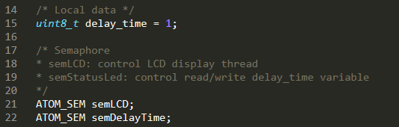
Threads
Led Thread
Button Thread
LCD Thread
Start
Init Clock/Timer/…
Init OS
Fail
Print log error
Success
Create 2 Semaphore
Crash
Success
led_thread
button_thread
display_thread

Slide 10
Threads
Led Thread
Button Thread
LCD Thread
Main thread
Init
Nháy led
atomSemGet(semDelayTime)
Update Delay
atomSemPut(semDelayTime)
Delay

Slide 11
Threads
Led Thread
Button Thread
LCD Thread
Main Thread
Init
atomSemGet(semDelayTime)
Update delay
atomSemPut(semDelayTime)
Toggle led

Slide 12
Threads
Led Thread
Button Thread
LCD Thread
Main thread
Init
atomSemGet(semLCD)
Printf();
atomSemGet(semLCD)

Slide 13
Threads
Led Thread
Button Thread
LCD Thread
Main Thread
Main thread
Init
Init
atomSemGet(semDelayTime)
atomSemGet(semLCD)
Update delay
Printf();
atomSemPut(semDelayTime)
atomSemPut(semLCD)
Toggle led

Slide 14
RTOS
Round Robin Schedule
Semaphore
Threads
Led Thread
Button Thread
LCD Thread
Debugging
Mode DEBUG/RELEASE
About
Integrated Technologys
About Team

Slide 15

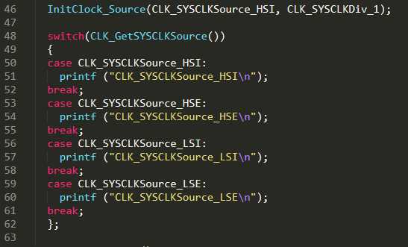
Debugging
Mode DEBUG/RELEASE

Slide 16
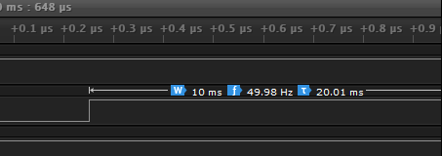
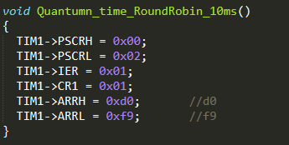
Debugging
Mode DEBUG/RELEASE

Slide 17
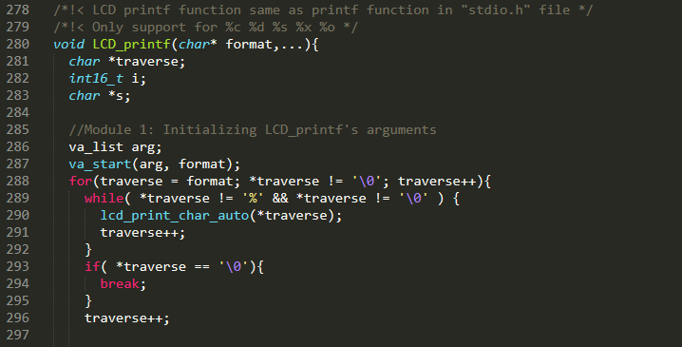
Debugging
Mode DEBUG/RELEASE

Slide 18
RTOS
Round Robin Schedule
Semaphore
Threads
Led Thread
Button Thread
LCD Thread
Debugging
Mode DEBUG/RELEASE
About
Integrated Technologys
About Team

Slide 19




About
Integrated Technologys
About Team
Travis-CI
Linux kernel coding convention
Easily sync your GitHub projects with Travis CI and you’ll be testing your code in minutes!
https://travis-ci.org/
This is a short document describing the preferred coding style for the linux kernel.
https://www.kernel.org/doc/html/v4.10/process/coding-style.html
Read the docs
GIT
Read the Docs simplifies software documentation by automating building, versioning, and hosting of your docs for you.
https://readthedocs.org/
Git is a free and open source distributed version control system designed to handle everything from small to very large projects with speed and efficiency.
https://git-scm.com/

Slide 20


About
Integrated Technologys
About Team

Slide 21





Trần Quang Diệu
Nguyễn Trần Kha
Team Member
Work on GPIO config
Team Member
Work on System Clock
Nguyễn Lương Duy Khánh
Lê Hoàng Phúc
Lê Trọng Thức
Team Leader
Team Member
Team Member
Config Quatumn Time & combinate Doccuments
KhanhnLD@fsoft.com.vn
Debug on RTOS
Debug on RTOS

